Slide 1
Recitation 4
Prof. Philip Brown

Slide 2
Some more style...
Style

Slide 3
Recall
Style
Style doesn’t matter to MATLAB
Code with different style can accomplish the same thing
Style helps you, other students, and the people grading your work better understand what you are trying to do
Today we will go over a few more things about style

Slide 4
White Space
Style
Blank lines separating sections of code
Usually good idea to put white space between
New conditional statements
Different groups of variables being assigned values
The function header and the rest of your function
Any parts of your program that are accomplishing different tasks

Slide 5
White Space – Tabs and Indenting
Style
Lets you know when code depends on the lines above it
Use when you have conditional statements!
Things that happen under conditions are indented further than the conditional statements
MATLAB does this automatically for you
Really helps once we start nesting conditions (later in the class)

Slide 6
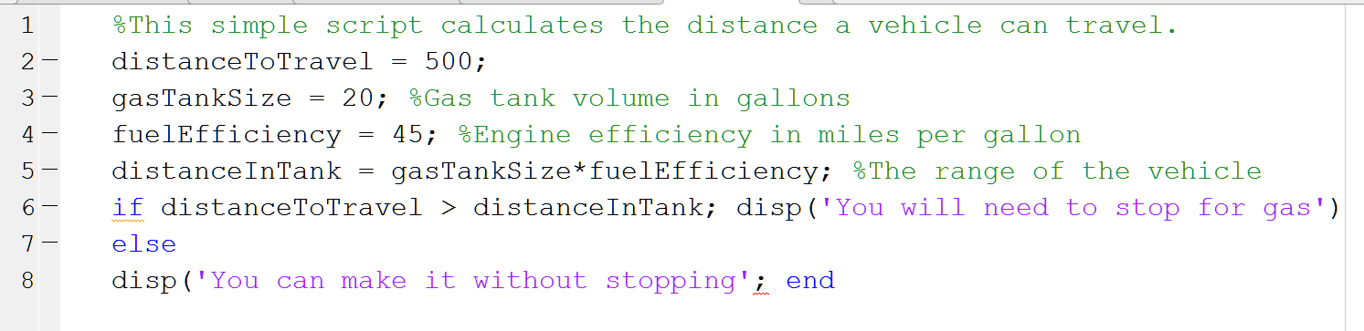
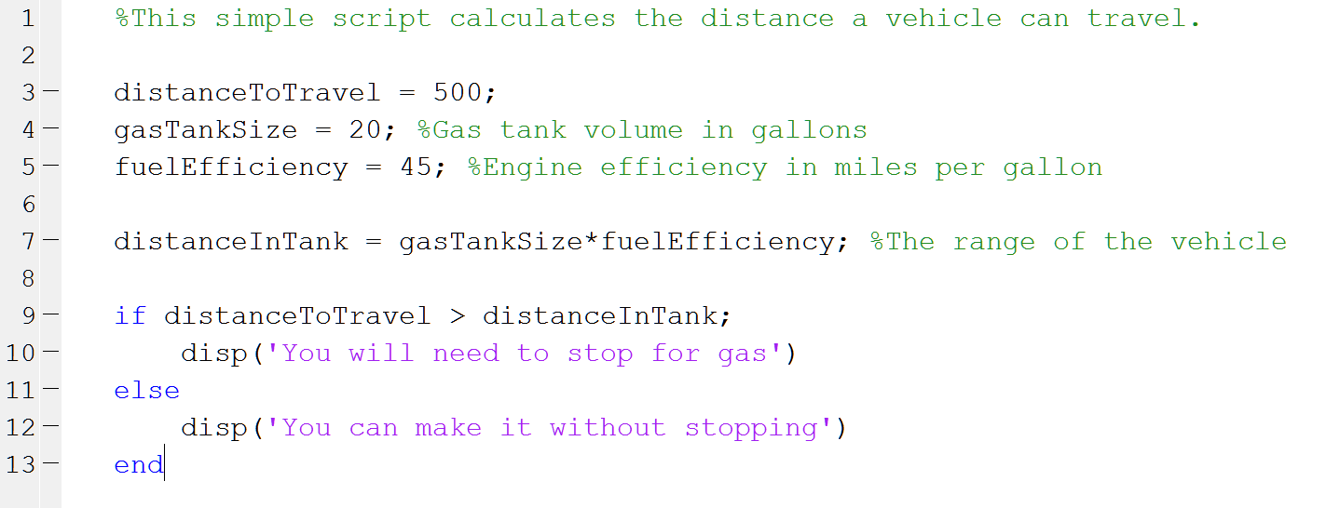
White Space vs. No White Space
Style
Header comments can help describe your code, overall, or a part of your code
Indents help you determine what is dependent on previous code
White space helps “section” your program

Slide 7
Comments
Style
Remember comments (denoted by %) should always play a role in your style
Many of my examples lack comments so as to save space
I am explaining them to you as you see them
Comments can help explain code when you aren’t there to do the explaining
At the very least, add a header comment (like in the previous example) stating what your code is supposed to do

Slide 8
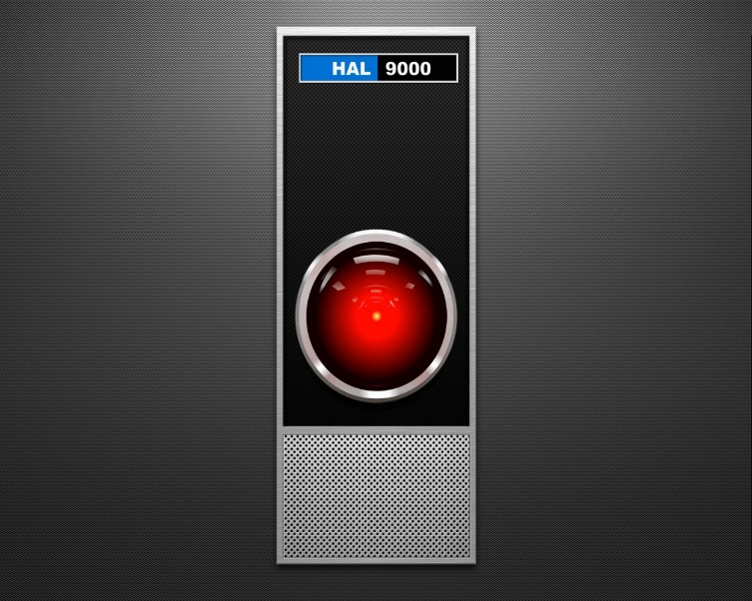

This Week’s Problem: Hal9000 and The Discovery 1

Slide 9
This Week
Hal9000 is supposed to write code to help the crew of the Discovery 1 spacecraft
He is in charge of keeping two systems online, and warning the crew about their malfunctions:
Oxygen
Artificial gravity centrifuge
However, Hal9000 is malfunctioning. His code is hard to understand, and it’s not passing the right messages to the crew
You have to fix it

Slide 10
Part 1: Oxygen System
Compares oxygen to earth levels (21%)
If levels are too high (greater than 50%) there is a fire hazard, and the crew needs to be warned
If the levels are too low (less than 14%) the crew is in danger of losing consciousness and must seek supplemental oxygen

Slide 11
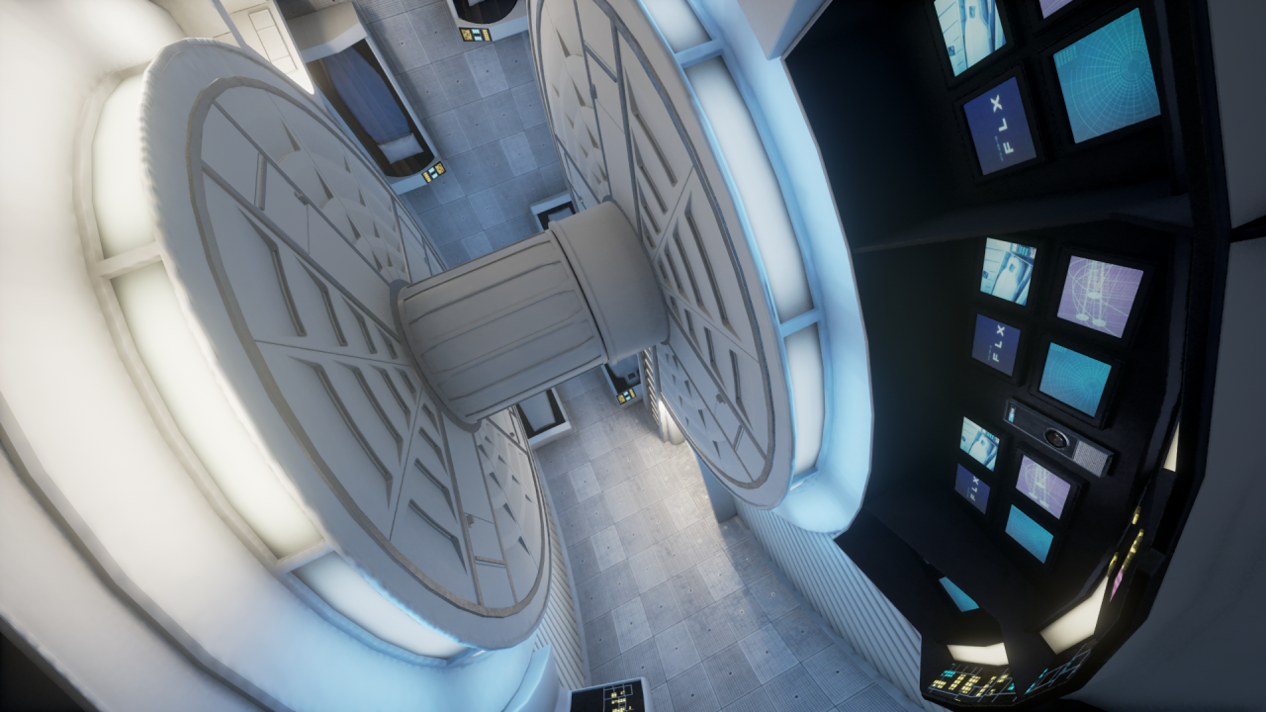
Part 1: Gravity Centrifuge

Slide 12
Part 1: Gravity Centrifuge
Centrifugal acceleration = tangential velocity² /radius;
The radius of the wheel is 8m
If the velocity is too high
Artificial gravity is too great, the crew might not be able to function properly
If the velocity is too low
Things might start to float, and the crew should know about it

Slide 13
Part 1: Fix Hal’s Code
No white space
No indents
No comments
No good variable names
You need to figure out what the code is doing, format it in good style, and fix the messages!

Slide 14
Part 2: Emergency Systems Manager
You must create some new code to use as a backup for Hal.
Take warnings and react to them
Turn on fire systems if oxygen is too high
Turn on wheel brake if gravity is too high
Turn on oxygen system if oxygen is low
Turn on wheel motor if gravity is too low
Each emergency system is represented by a Boolean variable
You should call code from Part 1 to solve Part 2

Slide 15
Part 2: MATLAB Function to use
boolean = strcmp(string1,string2);
Returns 1 if strings are the same
Returns 0 if strings are different

